Slide 1
Growth of Functions (函数增长)

Slide 2
The Growth of Functions
We quantify the concept that g grows at least as fast as f.
What really matters in comparing the complexity of algorithms?
We only care about the behavior for large problems.
Even bad algorithms can be used to solve small problems.
Ignore implementation details such as loop counter incrementation, etc. We can straight-line any loop.

Slide 3
Orders of Growth (§3.2)
For functions over numbers, we often need to know a rough measure of how fast a function grows.
If f(x) is faster growing than g(x), then f(x) always eventually becomes larger than g(x) in the limit (for large enough values of x).
Useful in engineering for showing that one design scales better or worse than another.

Slide 4
Orders of Growth - Motivation
Suppose you are designing a web site to process user data (e.g., financial records).
Suppose database program A takes f_{A}(n)=30n+8 microseconds to process any n records, while program B takes f_{B}(n)=n²+1 microseconds to process the n records.
Which program do you choose, knowing you’ll want to support millions of users?
A

Slide 5
Visualizing Orders of Growth
On a graph, as you go to the right, the faster- growing func- tion always eventually becomes the larger one...
f_{A}(n)=30n+8
Value of function →
f_{B}(n)=n²+1
Increasing n →

Slide 6
Concept of order of growth
We say f_{A}(n)=30n+8 is (at most) order n, or O(n).
It is, at most, roughly proportional to n.
f_{B}(n)=n²+1 is order n², or O(n²).
It is (at most) roughly proportional to n².
Any function whose exact (tightest) order is O(n²) is faster-growing than any O(n) function.
Later we will introduce Θ for expressing exact order.
For large numbers of user records, the exactly order n² function will always take more time.

Slide 7
The Big-O Notation
Definition:
Let f and g be functions from N or R to R. Then g asymptotically dominates (渐进地支配) f, denoted ‘f is O(g)’ or ‘f is big-O of g’ iff
∃k∃c∀n(n>k → |f(n)| ≤ c|g(n)|)
‘f is at most order g’, or ‘f is O(g)’ or ‘f =O(g)’ all just mean that f∈O(g).
Note:
Choose k, choose c which may depend on the choice of k.
Once you choose k and c, you must prove the truth of the implication (often by induction).
实际上相当于给出函数的渐进上界
k, c : witnesses(凭证) to the relationship f(x) is O(g(x))

Slide 8
Example

Slide 9
Points about the definition
Note that f is O(g) so long as any values of c and k exist that satisfy the definition.
But: The particular c, k, values that make the statement true are not unique: Any larger value of c and/or k will also work.
You are not required to find the smallest c and k values that work. (Indeed, in some cases, there may be no smallest values!)
However, you should prove that the values you choose do work.

Slide 10

little-o of g
In calculus
If
Then
f is o(g) (called little-o of g)

Slide 11
Theorem
If f is o(g) then f is O(g).
Proof:
by definition of limit as n goes to infinity, f(n)/g(n) gets arbitrarily small.
That is for any ε >0, there must be an integer N such that when n > N, | f(n)/g(n) | < ε .
Hence, choose c = ε and k = N.
Q. E. D.

Slide 12
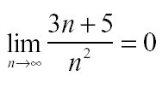
Example
3n + 5 is O(n²)
Proof: It's easy to show
using the theory of limits.
Hence 3n + 5 is o(n²) and so it is O(n²).
Q. E. D.

Slide 13
“Big-O” Proof Examples
Show that 30n+8 is O(n).
Show ∃c,k: ∀n>k: 30n+8 ≤ cn.
Let c=31, k=8. Assume n>k=8. Then cn = 31n = 30n + n > 30n+8, so 30n+8 < cn.
Show that n²+1 is O(n²).
Show ∃c,k: ∀n>k: n²+1 ≤ cn².
Let c=2, k=1. Assume n>1. Then cn² = 2n² = n²+n² > n²+1, or n²+1< cn².

Slide 14
Big-O example, graphically
Note 30n+8 isn’t less than n anywhere (n>0).
It isn’t even less than 31n everywhere to the left of n=8.
But it is less than 31n everywhere to the right of n=8.
y=cn =31n
y=30n+8
Value of function →
Increasing n →
∃c,k: ∀n>k: 30n+8 ≤ cn, thus 30n+8∈ O(n)

Slide 15
Some important Big-O results
Theorem 1
Let f(x) = a_{n}x^{n} + a_{n-1}x^{n-1} +…+ a₁x+a₀ ,where a₀ , a₁ , … a_{n-1}, a_{n} are real numbers. Then f(x) is O(x^{n}) .
n! is O(n^{n})
log n! is O(nlogn)
log n is O(n)
1, log n, n, nlogn, n², 2^{n}, n!

Slide 16
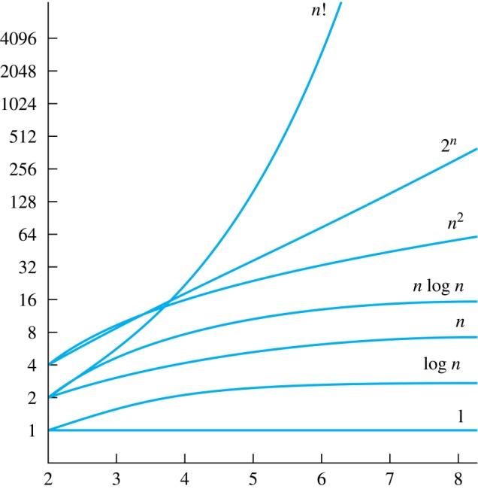
Display of Growth of Functions
1, log n, n, nlogn, n², 2^{n}, n!
Note the difference in behavior of functions as n gets larger

Slide 17
Useful Big-O Estimates Involving Logarithms, Powers, and Exponents
If d > c > 1, then
n^{c} is O(n^{d}), but n^{d} is not O(n^{c}).
If b > 1 and c and d are positive, then
(log_{b}n)^{c} is O(n^{d}), but n^{d} is not O((log_{b}n)^{c}).
If b > 1 and d is positive, then
n^{d} is O(b^{n}), but b^{n} is not O(n^{d}).
If c > b > 1, then
b^{n} is O(c^{n}), but c^{n} is not O(b^{n}).
原则：增长慢的可以向增长快的估计，但增长快的不能向增长慢的估计
应用：可以对不同函数的增长速度进行排序

Slide 18
Ordering Functions by Order of Growth
Put the functions below in order so that each function is big-O of the next function on the list.
f₁(n) = (1.5)^{n}
f₂(n) = 8n³+17n² +111
f₃(n) = (log n )²
f₄(n) = 2^{n}
f₅(n) = log (log n)
f₆(n) = n² (log n)³
f₇(n) = 2^{n} (n² +1)
f₈(n) = n³+ n(log n)²
f₉(n) = 10000
f₁₀(n) = n!
Successively find the function that grows slowest among all those left on the list.
f₉(n) = 10000 (constant, does not increase with n)
f₅(n) = log (log n) (grows slowest of all the others)
f₃(n) = (log n) ² (grows next slowest)
f₆(n) = n² (log n) ³ ((log n)³ factor smaller than any power of n)
f₈(n) = n³+ n(log n)² (tied with the one below)
f₂(n) = 8n³+17n² +111 (tied with the one above)
f₁(n) = (1.5) ^{n} (an exponential function)
f₄(n) = 2 ^{n} (grows faster than one above since 2 > 1.5)
f₇(n) = 2 ^{n} (n² +1) (grows faster than above because of the n² +1 factor)
f₁₀(n) = n！ ( n! grows faster than c^{n} for every c)

Slide 19
The growth of combinations of functions
Theorem 2
Suppose that f₁ is O(g₁) and f₂ is O(g₂) .Then f₁ + f₂ is O(max{ g₁, g₂})
Corollary 1
If f₁ , f₂ are both O(g) then f₁ + f₂ is O(g).
Theorem 3
Suppose that f₁ is O(g₁) and f₂ is O(g₂) .Then f₁f₂ is O(g₁g₂)

Slide 20
Proof of f₁f₂ is O(g₁g₂)
There is a k₁ and c₁ such that
1. f₁(n) < c₁g₁(n)
when n > k₁.
There is a k₂ and c₂ such that
2. f₂(n) < c₂g₂(n)
when n > k₂.
We must find a k₃ and c₃ such that
3. f₁(n)f₂(n) < c₃g₁(n)g₂(n)
when n > k₃.

Slide 21
Proof of f₁f₂ is O(g₁g₂)
We use the inequality
if 0 < a < b and 0 < c < d then ac < bd
to conclude that
f₁(n)f₂(n) < c₁c₂g₁(n)g₂(n)
as long as k > max{k₁, k₂} so that both inequalities 1 and 2. hold at the same time.
Therefore, choose
c₃ = c₁c₂
and
k₃ = max{k₁, k₂}.
Q. E. D.

Slide 22
Example
Find the complexity class of the function
(nn!+ 3^{n+2} + 3n¹⁰⁰ )(n^{n} + n2^{n} )
Solution:
This means to simplify the expression.
Throw out stuff which you know doesn't grow as fast. And at last:
nn! n^{n}

Slide 23
Big-omega notation
Definition: Let f and g be functions from N or R to R. We say f is Ω(g) or 'f is big- Ω of g,' iff
∃k∃c∀n[n > k→| f (n) |>c | g(n) |]
Note:
Choose k
Choose c; it may depend on your choice of k
Once you choose k and c, you must prove the truth of the implication (often by induction)
实际上相当于给出函数的渐进下界
In particular, f(x) is Ω(g(x)) if and only if g(x) is O(f(x)).

Slide 24
Big-theta notation
If f∈O(g) and g∈O(f), then we say “g and f are of the same order” or “f is (exactly) order g” and write f∈Θ(g).
Another, equivalent definition: Θ(g) ≡ {f:R→R | ∃c₁c₂k>0 ∀x>k: |c₁g(x)|≤|f(x)|≤|c₂g(x)| }
“Everywhere beyond some point k, f(x) lies in between two multiples of g(x).”
互为渐进上界
f∈O(g) and f∈Ω(g)
通过上界和下界确定了函数的阶
f(x)和 g(x)具有相同的阶
f∈Θ (g) and g∈Θ (f)

Slide 25
Θ example
Determine whether:
Quick solution:

Slide 26
Theorem 4
Let f(x) = a_{n}x^{n} + a_{n-1}x^{n-1} +…+ a₁x+a₀ ,where a₀ , a₁ , … a_{n-1}, a_{n} are real numbers with a_{n}≠ 0 . Then f(x) is of order x^{n} .
Method:
Show f(x) is O(x^{n}) and f(x) is Ω(x^{n}).
Remember:
Leading term of a polynomial determines its order.

Slide 27
Review: Orders of Growth (§3.2)
Definitions of order-of-growth sets, ∀g:R→R
O(g) :≡ {f | ∃ c>0 ∃k ∀x>k |f(x)| < |cg(x)|}
o(g) :≡ {f | ∀c>0 ∃k ∀x>k |f(x)| < |cg(x)|}
Ω(g) :≡ {f | g∈O(f)}
Ω(g) :≡{f | ∃ c>0 ∃k ∀x>k |f(x)| ≥ |cg(x)|}
Θ(g) :≡ O(g) ∧ Ω(g)
Θ(g) ≡ {f |∃c₁c₂k>0 ∀x>k |c₁g(x)|≤|f(x)|≤|c₂g(x)|}

Slide 28
Homework
§3.2
34,74

